Slide 1
TRANSISTOR AS AN AMPLIFIER

Slide 2
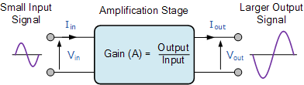
Amplifier
An amplifier is a device which use electrical signal of small value at input and provide a large value of electric signal at output.
An amplifier is an electronic device or circuit which is used to increase the magnitude of the signal applied to its input.
Transistors are basically used as amplifier, which is the basic building block of every complex electronic circuit.

Slide 3
There are many forms of electronic circuits classed as amplifiers, from Operational Amplifiers and Small Signal Amplifiers up to Large Signal and Power Amplifiers.
The classification of an amplifier depends upon the size of the signal, large or small, its physical configuration and how it processes the input signal, that is the relationship between input signal and current flowing in the load.

Slide 4
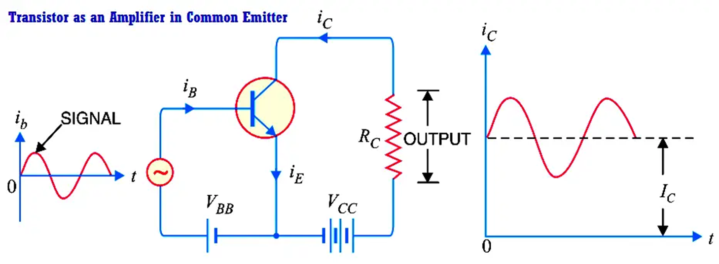

In the circuit of common-emitter amplifier, base – emitter is input & collector emitter is output.
The battery VBB forward biases the emitter base junctions.
The battery VCC reverse biases the collector base junction. VCC is much larger than VBB.
VBE and VCE are input and output voltages respectively.
The base current IB where rie is input resistance of the emitter-base junction.
$$I_{B}=\frac{V_{BE}}{r_{ie}}$$

Slide 5






The transistor amplifies it β -times.
$$∵β=\frac{I_{C}}{I_{B}}$$
$${∵I}_{B}=\frac{V_{BE}}{r_{ie}}$$
$$I_{c}=\frac{βV_{BE}}{r_{ie}}$$
$$I_{C}=βI_{B}$$
The output voltage Vo = VCE is determined by applying KVL equation in the output loop which gives
$$V_{CC}=I_{C}R_{C}+V_{CE}$$
$$V_{CE}=V_{CC}−I_{C}R_{C}$$
Substituting value of IC and replacing VCE by Vo.
$$V_{o}=V_{CC}−βV_{BE}×R_{C}\text{/}\text{rie}\text{ (1) }$$
When a small input voltage ΔVin is applied at the input terminal B, the input voltage changes from VBE to VBE + ΔVin which causes a little change in bas e current from IB to (IB + ΔIB).
So collector current changes from IC to (IC + ΔIC).
As the collector current changes, the voltage drop across RC.. i.e., (ICRC) also changes due to which the output voltage changes by ΔVo.

Slide 6







Substituting the changed values in equation (1)
$V_{o}=V_{CC}−βV_{BE}×R_{C}\text{/}\text{rie}$ (1)
$$V_{o}+ΔV_{o}$$
$=V_{CC}−β(V_{BE}+ΔV_{in})R_{C}/r_{ie}$ (2)
subtracting equation (1) from equation (2)
$$V_{o}+ΔV_{o}{{−V}_{o}=V_{CC}−β(V_{BE}+ΔV_{in})R_{C}/r_{ie}{−V}_{CC}+βV_{BE}×R_{C}\text{/}\text{rie} V}_{o}$$
$$V_{o}+ΔV_{o}{−V}_{o}V_{CC}−β(V_{BE}+ΔV_{in})R_{C}/r_{ie}{−V}_{CC}+β×R_{C}\text{/}\text{rie}$$
$ΔV_{o}=−βV_{BE}R_{C}/r_{ie}$ $−βΔV_{in}R_{C}/r_{ie}$ $+βV_{BE}×R_{C}\text{/}\text{rie}$
$$ΔV_{o}=−βΔV_{in}R_{C}/r_{ie}$$
Negative sign shows the phase shift of 180 b/w input & output signals.
Thus, input voltage is amplified.
$$ΔV_{o}=−βΔV_{in}R_{C}/r_{ie}$$
$$\frac{ΔV_{o}}{ΔV_{in}}=−β\frac{R_{C}}{r_{ie}}$$
V_{Gain} = $−$ I _{gain}x Rgain_{gain}

Slide 7
APPLICATIONS OF TRANSISTOR AS AN AMPLIFIER
Audio Amplification:
Transistors amplify weak audio signals from devices like microphones, allowing them to drive speakers or headphones.
Light Amplification in Optoelectronics:
Transistors can be used in optoelectronic devices to amplify signals related to light, such as in optical communication systems and photodetectors.
Biomedical Amplifiers:
Transistors are used in biomedical applications to amplify signals from sensors monitoring physiological parameters, facilitating medical diagnostics and research.
Power Amplifiers:
Transistors can be used in power amplifiers to increase the power of electrical signals, particularly in applications where a higher output power is required, like driving loudspeakers in audio systems.

Slide 8
TRANSISTOR AS a SWITCH

Slide 9
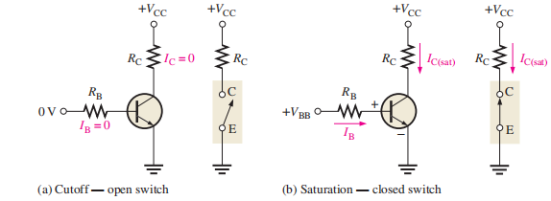
The transistor as a Switch
The basic operation of a BJT as a switching device.
In part (a)The transistor is in the cutoff region because the base-emitter junction is not forward-biased.
In part (b), the transistor is in the saturation region because the base emitter junction and the base-collector junction are forward-biased and the base current is made large enough to cause the collector current to reach its saturation value.

Slide 10


Conditions in Cutoff
As mentioned before, a transistor is in the cutoff region when the base-emitter junction is not forward-biased .
Neglecting leakage current, all of the currents are zero, and VCE is equal to VCC.
Conditions in Saturation
when the base emitter junction is forward-biased and there is enough base current to produce a maximum collector current, the transistor is saturated.
The formula for collector saturation current is
The minimum value of base current needed to produce saturation is

Slide 11
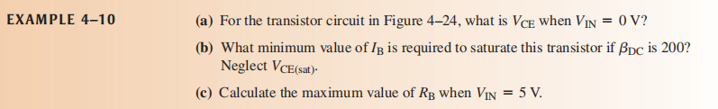
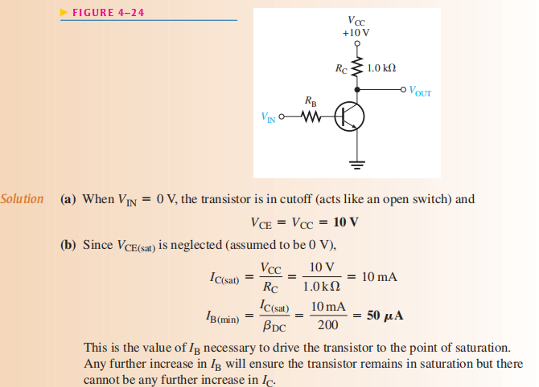
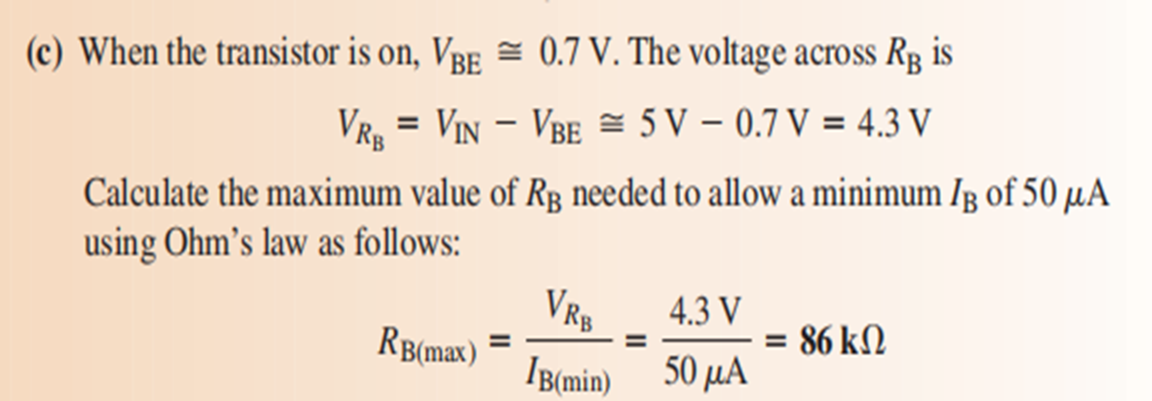

Slide 12
Alpha and Beta Relation

Slide 13
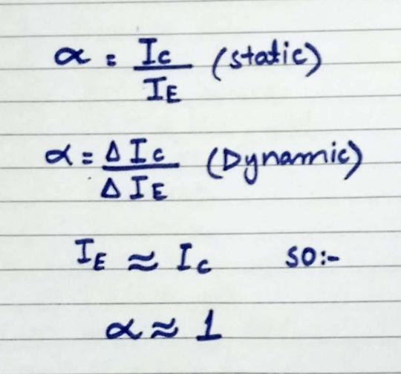
DC Beta (𝜷DC) and DC Alpha ( DC)
The ratio of the dc collector current (IC) to the dc emitter current (IE) is the dc alpha (aDC). The alpha is a less-used parameter than beta in transistor circuits. values of aDC range from 0.95 to 0.99 or greater, but aDC is always less than 1.
The reason is that IC is always slightly less than IE by the amount of IB.

Slide 14
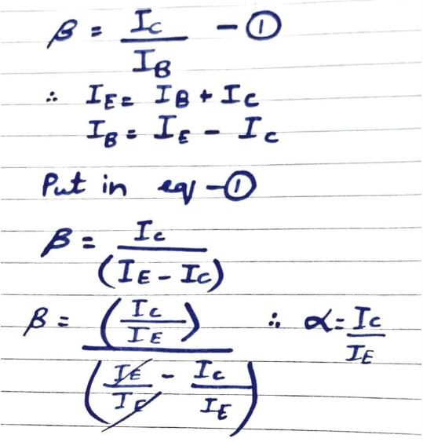
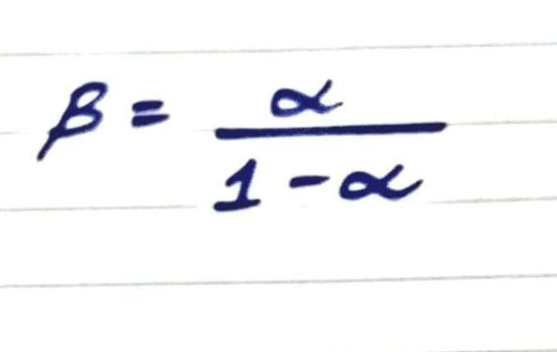
The dc current gain of a transistor is the ratio of the dc collector current (IC) to the dc base current (IB) and is designated dc beta (bDC). Typical values of bDC range from less than 20 to 200 or higher.

Slide 15
BJT CIRCUIT ANALYSIS

Slide 16
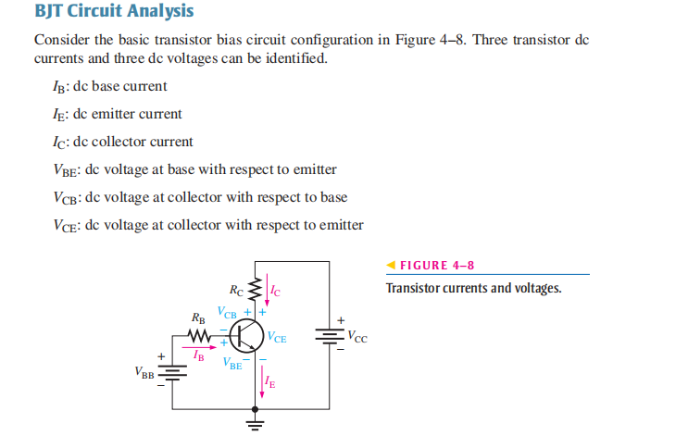

Slide 17
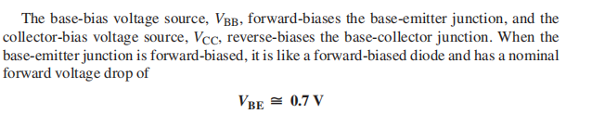


Slide 18
